Slide 1
Team Builder Bonus
Dates: 23 October 2:59pm AEDT – 31 December 2023

Slide 2
BRAND NEW PROMOTION
WHY?
Simplify bonus programs
$5K Relay / Executive Lifestyle – final month October 2023
Additional rewards for those who consistently hold Manager and above rank
Reward you for maintaining customer retention
Reward long-term sustainable business practices
More Consultants and above potential to earn more income

Slide 3
TEAM BUILDERS
CONSULTANT & ABOVE

Slide 4
CRITERIA – CONSULTANTS & ABOVE
YOU
New Customer 1
100QV
New Customer 2
100QV
COMMISSION MONTH
STEP 1
Personally enrol 2 NEW customers*
- 100QV Minimum order
- On subscription rewards
- During the commission month
Results not typical. For illustration purposes only. See IsagenixEarnings.com.
*Customer referral program enrollments are excluded

Slide 5
CRITERIA – CONSULTANTS & ABOVE
STEP 2
Maintain Paid-As Consultant or Higher
- Minimum 3 out of 4 commission weeks in a 4-week commission month
OR
- 4 out of 5 in a 5-week commission month
= YOU HAVE UNLOCKED
Team Builders Bonus from Day 1 - 90
YOU
New Customer 1
100QV
New Customer 2
100QV
CONSULTANT OR HIGHER
COMMISSION MONTH
Results not typical. For illustration purposes only. See IsagenixEarnings.com.
*Customer referral program enrollments are excluded

Slide 6
REWARD – CONSULTANTS & ABOVE
Customer | First 90 Days | Example
PET Level | Your Reward | October (Day 1 – 28)
1PET | Day 1 = 20% PIB Day 2 – 90 = 10% of BV |  | 20% PIB | $331.64
2PET | Day 1 – 90 = 8% of BV |  | 8% | $48.96
3PET | Day 1 – 90 = 6% of BV |  | 6% | $36.72
4PET | Day 1 – 90 = 4% of BV |  | 4% | $24.48
Based on all NEW Subscription Customers within the October Commission Month |  |  |  | $441.80
204BV
204BV
204BV
204BV
204BV
204BV
204BV
204BV
204BV
204BV
204BV
204BV
204BV
Results not typical. For illustration purposes only. See IsagenixEarnings.com.
*Customer referral program enrollments are excluded

Slide 7
REWARD – CONSULTANTS & ABOVE
Customer | First 90 Days | Example Same enrolments from October also reorder in November
PET Level | Your Reward | November (Day 29 – 56)
1PET | Day 2 – 90 = 10% of BV |  | 10% | $52
2PET | Day 1 – 90 = 8% of BV |  | 8% | $31.20
3PET | Day 1 – 90 = 6% of BV |  | 6% | $23.40
4PET | Day 1 – 90 = 4% of BV |  | 4% | $15.60
Based on your NEW October Subscription Customers re-orders in November |  |  |  | $122.20
Average monthly BV per order ANZ
130BV
130BV
130BV
130BV
130BV
130BV
130BV
130BV
130BV
130BV
130BV
130BV
130BV
Results not typical. For illustration purposes only. See IsagenixEarnings.com.
*Customer referral program enrollments are excluded

Slide 8
REWARD – CONSULTANTS & ABOVE
Customer | First 90 Days | Example Same enrolments from October also reorder in December
PET Level | Your Reward | December (Day 56 - 90)
1PET | Day 2 – 90 = 10% of BV |  | 10% | $52
2PET | Day 1 – 90 = 8% of BV |  | 8% | $31.20
3PET | Day 1 – 90 = 6% of BV |  | 6% | $23.40
4PET | Day 1 – 90 = 4% of BV |  | 4% | $15.60
Based on your NEW October Subscription Customers re-orders in November |  |  |  | $122.20
130BV
130BV
130BV
130BV
130BV
130BV
130BV
130BV
130BV
130BV
130BV
130BV
130BV
Results not typical. For illustration purposes only. See IsagenixEarnings.com.
*Customer referral program enrollments are excluded

Slide 9
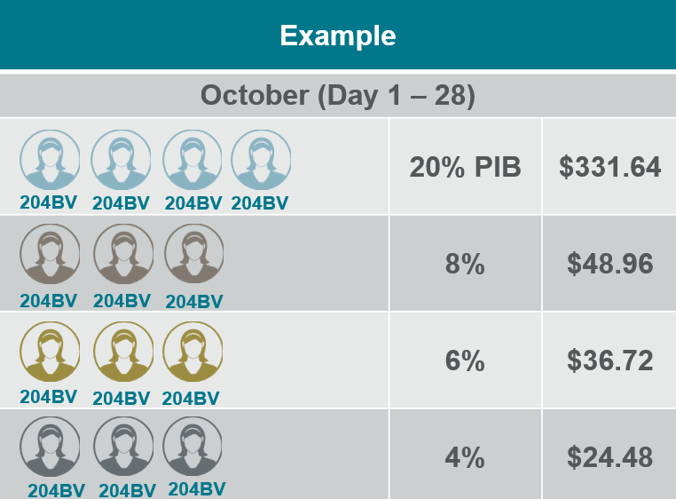
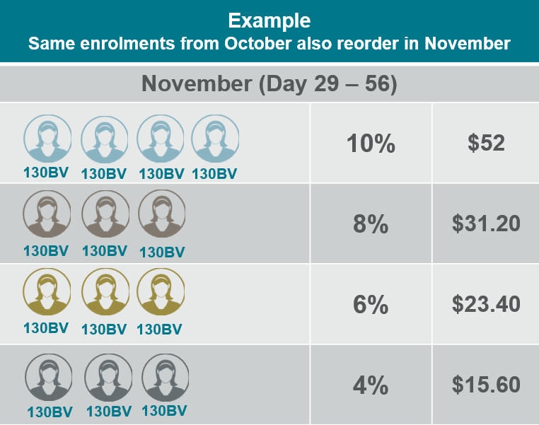
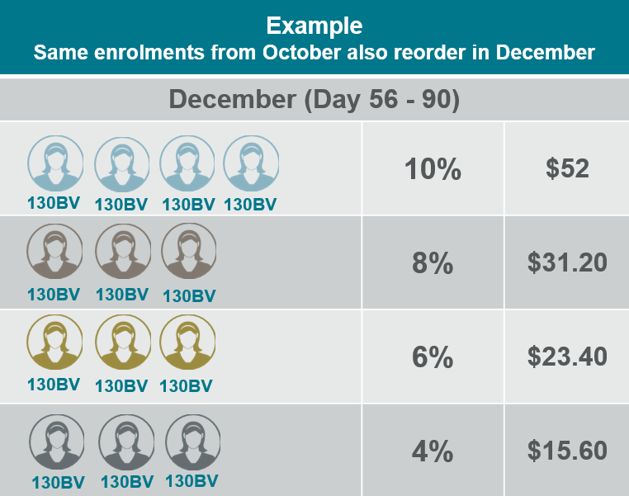
REWARD – CONSULTANTS & ABOVE
Based on just the enrolments in October over their first 90 days
(1 order per month for 3 months) you have earned:
October 20% PIB $331.64
+
October Team Builders Bonus $110.16
+
November Team Builders Bonus $122.20
+
December Team Builders Bonus $122.20
$331.64 + $354.56 = $686.20
Results not typical. For illustration purposes only. See IsagenixEarnings.com.
*Customer referral program enrollments are excluded

Slide 10
TEAM BUILDERS
MANAGER & ABOVE

Slide 11
CRITERIA – MANAGER & ABOVE
ADVANCE TO STEP 3
Maintain Paid-As Manager or Higher
- Minimum 3 out of 4 commission weeks in a 4-week commission month
OR
- 4 out of 5 in a 5-week commission month
= YOU HAVE NOW UNLOCKED
Retention Bonus from Day 91 - 365
YOU
New Customer 1
100QV
New Customer 2
100QV
MANAGER OR HIGHER
COMMISSION MONTH
Results not typical. For illustration purposes only. See IsagenixEarnings.com.
*Customer referral program enrollments are excluded

Slide 12
REWARD – MANAGER & ABOVE
Customer | Remaining 275 Days | Example Same enrolments from October also reorder in January
PET Level | Your Reward | Day 91 – 121
1PET | Day 91 – 121 = 5% of BV |  | 5% | $26
2PET | Day 91 – 121 = 4% of BV |  | 4% | $15.60
3PET | Day 91 – 121 = 3% of BV |  | 3% | $11.70
4PET | Day 91 – 121 = 2% of BV |  | 2% | $7.80
Based on your NEW October Subscription Customers re-orders in January |  |  |  | $61.10
130BV
130BV
130BV
130BV
130BV
130BV
130BV
130BV
130BV
130BV
130BV
130BV
130BV
Results not typical. For illustration purposes only. See IsagenixEarnings.com.
*Customer referral program enrollments are excluded

Slide 13
REWARD – MANAGER & ABOVE
Customer | Remaining 275 Days | Example Same enrolments from October also reorder in February
PET Level | Your Reward | Day 122 – 152
1PET | Day 122 – 152 = 5% of BV |  | 5% | $26
2PET | Day 122 – 152 = 4% of BV |  | 4% | $15.60
3PET | Day 122 – 152 = 3% of BV |  | 3% | $11.70
4PET | Day 122 – 152 = 2% of BV |  | 2% | $7.80
Based on your NEW October Subscription Customers re-orders in February |  |  |  | $61.10
130BV
130BV
130BV
130BV
130BV
130BV
130BV
130BV
130BV
130BV
130BV
130BV
130BV
Results not typical. For illustration purposes only. See IsagenixEarnings.com.
*Customer referral program enrollments are excluded

Slide 14
REWARD – MANAGER & ABOVE
October 20% PIB $331.64
+
October Team Builders Bonus $110.16
+
November Team Builders Bonus $122.20
+
December Team Builders Bonus $122.20
First 90 Days: $331.64 + $354.56 = $686.20
January Retention Bonus $61.10
+
February Retention Bonus $61.10
+
March Retention Bonus $61.10
+
April Retention Bonus $61.10
+
May Retention Bonus $61.10
+
June Retention Bonus $61.10
+
July Retention Bonus $61.10
+
August Retention Bonus $61.10
+
September Retention Bonus $61.10
Day 91 – 365: = $549.90
Based on just the
NEW Subscription Customers who joined in October re-orders
(1 order per month for 12 months) you have earned:
October 20% PIB $331.64
+
Team Builders Day 1-90 Bonus $354.56
+
Retention Day 91 – 365 Bonus $549.90
Combined Total = $1,236.10

Slide 15
REWARD OVERVIEW
Customer | CON - EXEC Reward | MGR - EXEC Reward
PET LEVEL | First 90 Days | Remaining 275 Days
1PET | Day 2 – 90 = 10% of BV | Day 91 – 365 = 5% of BV
2PET | Day 1 – 90 = 8% of BV | Day 91 – 365 = 4% of BV
3PET | Day 1 – 90 = 6% of BV | Day 91 – 365 = 3% of BV
4PET | Day 1 – 90 = 4% of BV | Day 91 – 365 = 2% of BV
Results not typical. For illustration purposes only. See IsagenixEarnings.com.
*Customer referral program enrollments are excluded

Slide 16
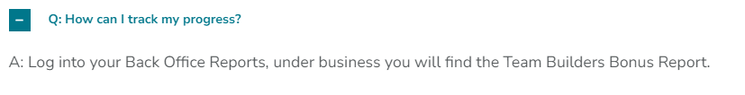

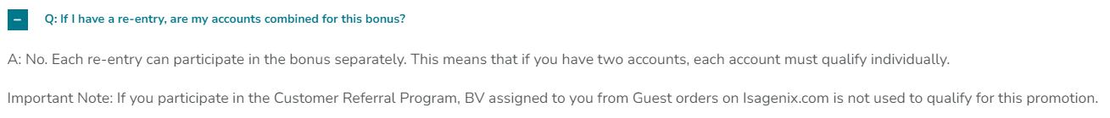
Q&A

