Slide 15
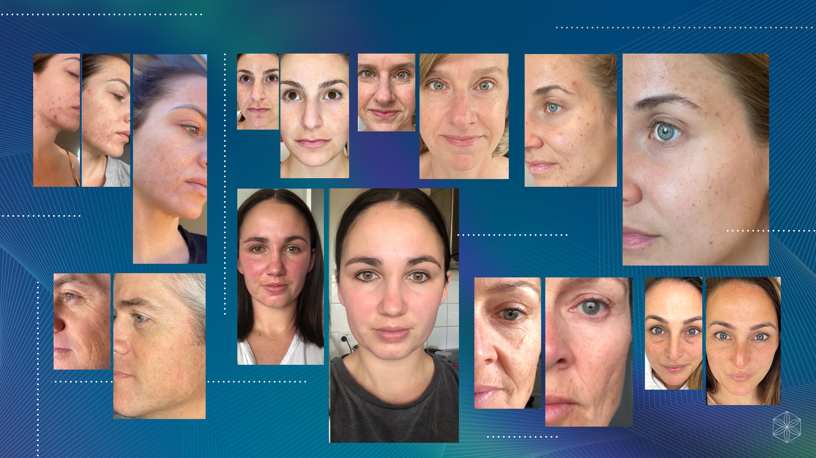

Slide 20
Notes:
The first way to earn income by partnering with Isagenix is through 20% referral commissions – you refer a product or pack to someone and earn a 20% commission on the pre-GST price of whatever they purchase. As an example: If a friend buys a $600 pack, you’ll earn $120 in commission. If another friend buys a $600 pack, you earn another $120 which means you’ve made $240 right away

Slide 21
Notes:
You’ll also earn a $50 bonus, bringing your total earnings to $290

Slide 22
Notes:
If both friends were to repeat what you just did, you’d earn $100 for each. That’s a total of $490!

Slide 23
Notes:
PLUS you can earn an additional $250 bonus from Isagenix if you hit this goal within the first 60 days

Slide 24
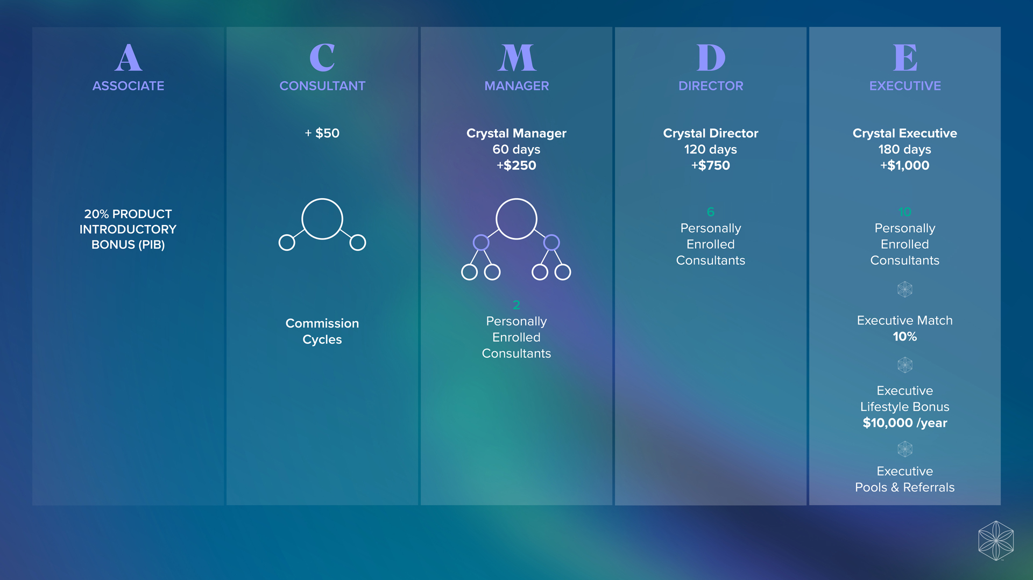
Notes:
Within Isagenix there are five ranks. You begin as an Associate then grow to Consultant, Manager, Director and Executive. Here we can see the different ways you can potentially earn income with Isagenix at each rank.

Slide 25
Notes:
Cycles are where the real money happens, it’s that life-changing money that allows you to support mortgage payments, boost your retirement fund and give yourself and your family some financial flexibility. So how are Cycles achieved? By not only sharing Isagenix with people within your sphere of influence but also by helping the people you share with to then share within their sphere of influence and so on.

Slide 27
Notes:
Whether you’re interested in biohacking for healthy ageing and longevity or if you’re looking to change your body, our flagship packs are the perfect place to begin for tasty, convenient, targeted nutrition for long-term health and wellbeing.

